Slide 1

Health is a human right
Norkiah Arsat PhD
Department of Nursing
University Malaysia Sabah

Slide 2
Outline
Health Is A Human Right
The Role Of Nurses In The Right To Health
Access, Investment And Economic Growth

Slide 3
Introduction
Health is a Human Right: Access, Investment and Economic Growth is the International Council of Nurses’ (ICN) International Nurses Day (IND) theme for 2018.
The theme examines opportunities to improve health care access and outcomes through applying a human rights approach to health systems development.

Slide 4
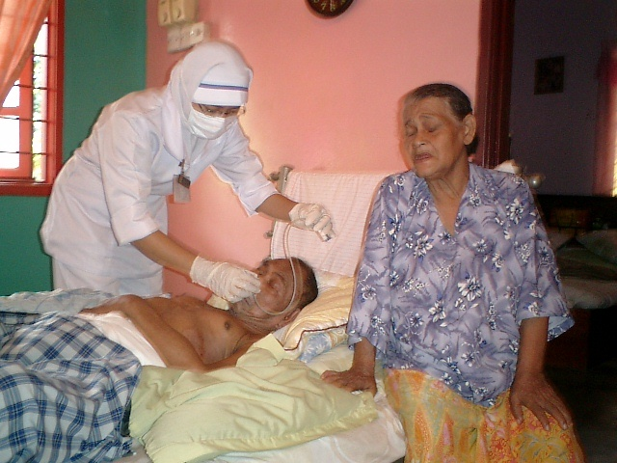
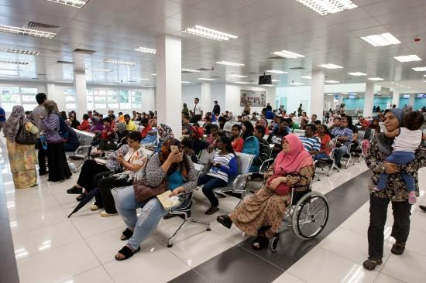
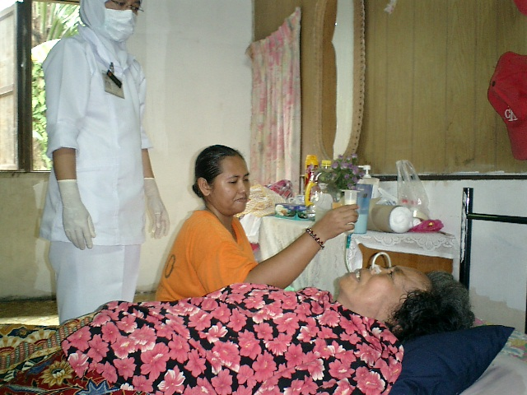
Health Is A Human Right
Applying a human rights based approach to health care places onus on society to take action to make appropriate health care equally available to everyone, particularly when most needed.
Setting health as a human right provides a powerful mechanism for community empowerment by enabling people to understand and exercise their rights to health, to pursue complaints and to address health care systems’ non-compliance.

Slide 5

The human right to health
The human right to health means that everyone has the right to the highest attainable standard of physical and mental health, which includes access to all medical services, sanitation, adequate food, decent housing, healthy working conditions, and a clean environment.

Slide 6
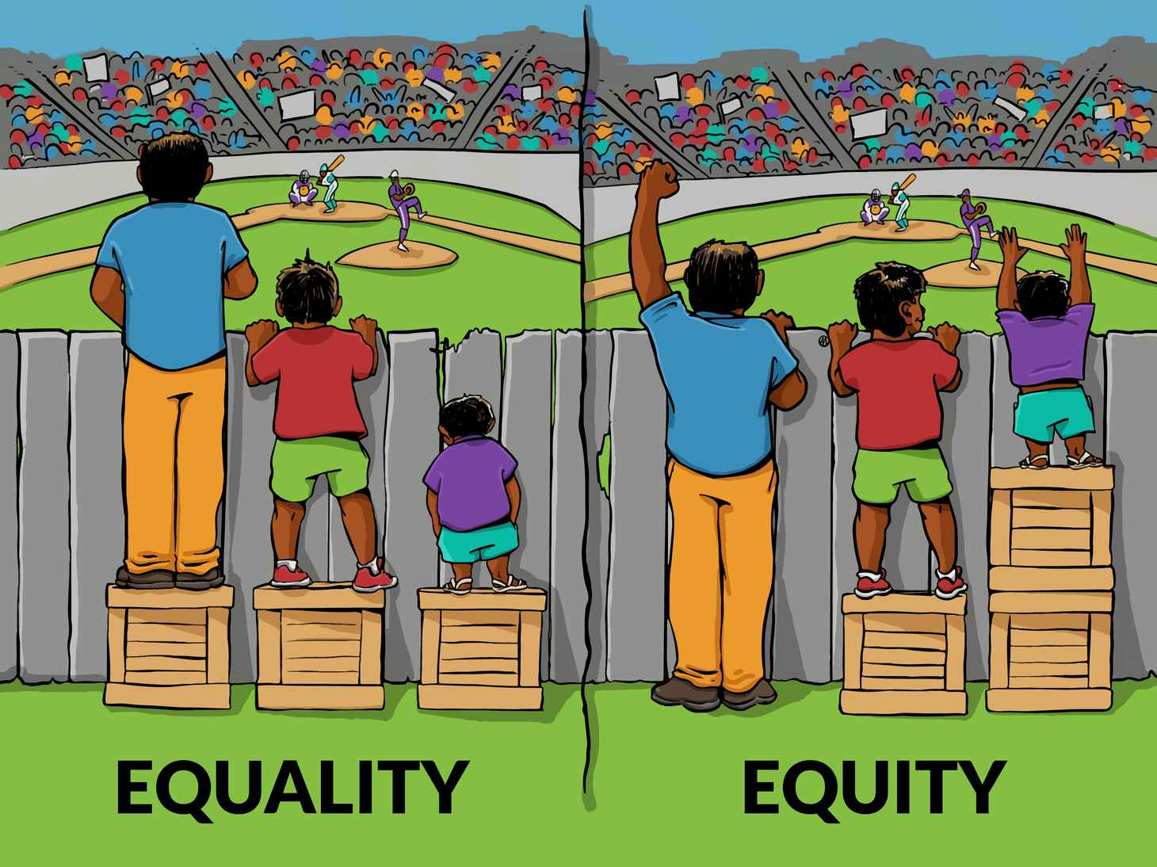
Key health-related human rights
Freedom from: discrimination; torture; inhuman or degrading treatment and harmful traditional
practices; and freedom of association, assembly and movement.
Rights to: life; education; food and nutrition; privacy; participation; individual autonomy and physical
integrity; to benefit from scientific progress (and its application); and to receive and to impart
information.

Slide 7
Core elements of a right to health
Availability
Accessibility:
Acceptability
Quality
sufficient quantity of functioning public health and health care facilities, goods and services, as well as programs for all.
non-discrimination
physical accessibility
economical accessibility (affordability)
information accessibility
Quality - key component of Universal Health Coverage, includes the experience as well as the perception of health care.
Safe, Effective,
People-centred
Timely,
Equitable,
Integrated &
Efficient .
respect for medical ethics
culturally appropriate,
sensitivity to gender.
health facilities, goods, services
people-centred
cater for the specific needs of diverse population groups
in accordance with international standards of medical ethics for confidentiality
informed consent.

Slide 8
From the public health perspective, the right to the highest attainable standard of health also includes the rights to:
comprehensive primary health care;
adequate, accessible, acceptable, affordable, appropriate and equitable health care services;
basic immunizations;
adequate nutrition;
adequate housing;
freedom from violence;
sexual and reproductive health information and services, including family planning;
underlying preconditions to health, for example the right to safe water and adequate sanitation; and, in general, the right to a clean and safe environment; and
information about health.

Slide 9
‘The right to health does not mean the right to be healthy, nor does it mean that poor governments must put in place expensive health services for which they have no resources. But it does require governments and public authorities to put in place policies and action plans which will lead to available and accessible health care for all in the shortest possible time. To ensure it happens is the challenge facing the human rights community and public health professionals.’
Mary Robinson, former UN High Commissioner for Human Rights.

Slide 10
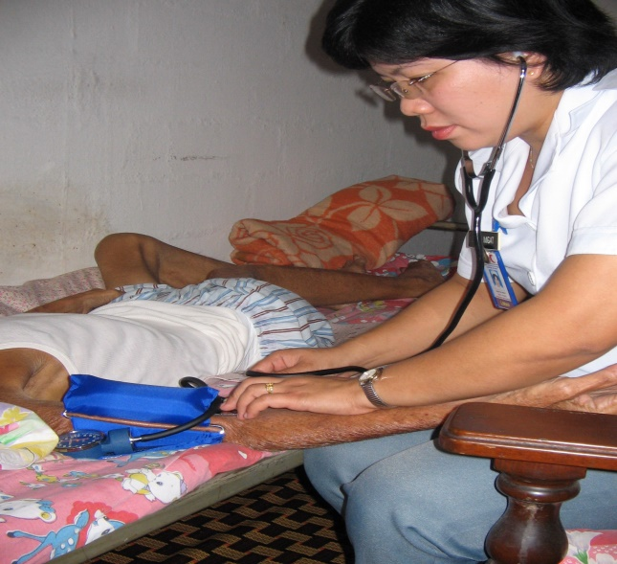
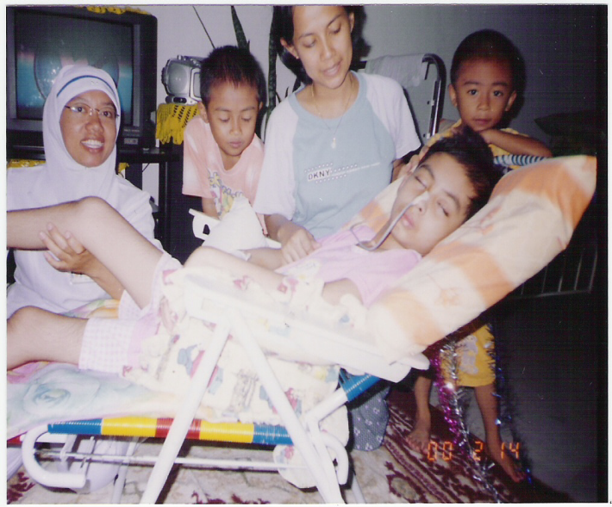
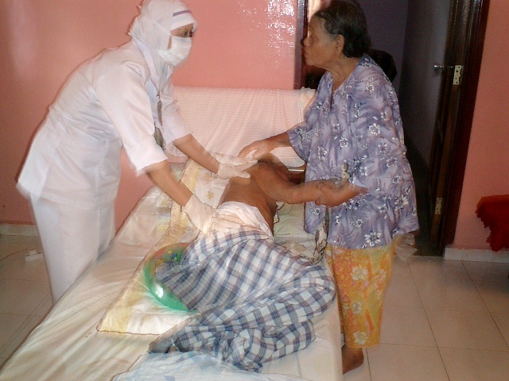
The Role Of Nurses In The Right To Health
A human rights approach to health also is the philosophical basis of nursing in Malaysia
The Malaysian Public Health Nursing Philosophy is based on "individual self-worth" in accordance with the basic purpose of caring care.
Malaysian nurses advocate for the protection of health as a human right through the provision of holistic , person-centred, prioritises safety, quality and access equity by providing comfort and helping individuals with health problems physically, mentally, socially and spiritually so they can achieve optimum health.
Nurses can lead and support health systems in applying a right-to-health approach across all areas of health care.

Slide 11
Health Is A Human Right : ACCESS, INVESTMENT AND ECONOMIC GROWTH
Understanding issues of health care systems ACCESS, INVESTMENT and ECONOMIC GROWTH informs nursing practice and contributions to health care policy development.

Slide 12
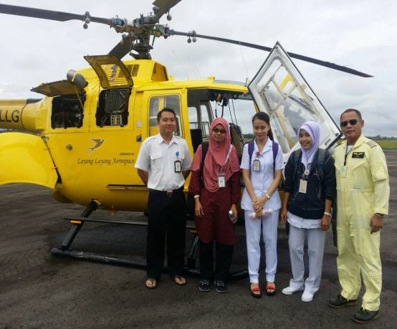
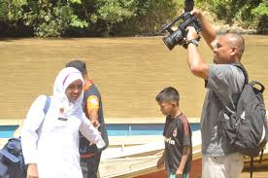
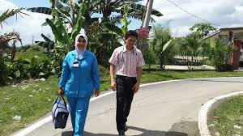
Health Is A Human Right : ACCESS
Is “the opportunity to reach and obtain appropriate health care services in situations of perceived need for care.”

Slide 13
Malaysia Health Care Service :
2 Tier System
RC
RC
RC
RC
HC
HC
4000
4000
4000
4000
RC
RC
RC
RC
RC
HC
RC
4000
15 -20,000
4000
4000
4000
15 -20,000
4000
4000
RC
RC
RC
RC
RC
HC
HC
RC
4000
15 -20,000
4000
4000
4000
4000
4000
RC
RC
RC
RC
100,000 Population
4000
15 -20,000
4000
4000
15 -20,000
4000
13

Slide 14
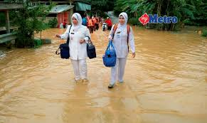

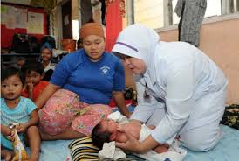
Health Is A Human Right : ACCESS
Nurses forefront of health care and are able to transform health care systems to improve access through a human rights approach.

Slide 15
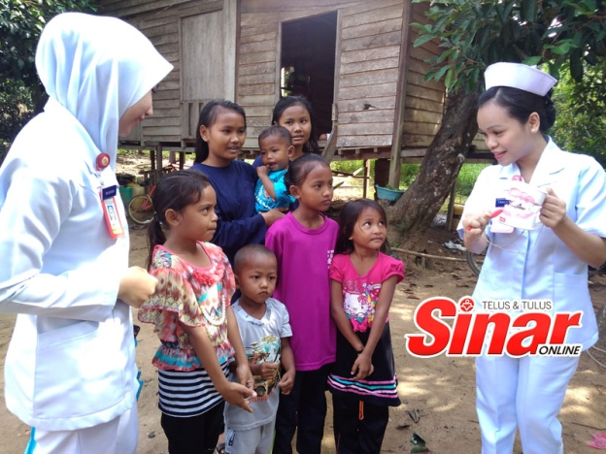
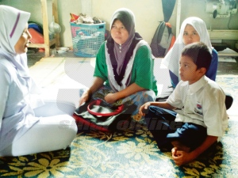
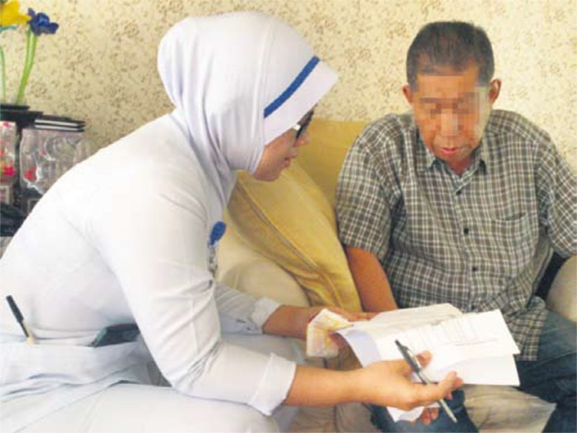
Health Is A Human Right : ACCESS
Nurses advocate for the protection of health as a human right through the provision of holistic, person-centred, evidence-based health care that prioritises safety, quality and access equity.
Act in the best interest of health care consumers.
Advocacy drives nurses to develop efficient, effective and sustainable models of care making nurses crucial to the health care reform agenda.

Slide 16
Health Is A Human Right : Determinants Of Health Care Access:
Public Awareness | Appropriate services exist and people are willing and know how to use them.
Service capability to meet diverse needs | non-discriminatory, aim to protect human rights and take an approach that seeks to provide culturally safe and appropriate, effective and responsive health care.
Easy service reach | Services are available, easy to reach and act to breakdown service barriers associated with geographic remoteness and/or social isolation.
Affordable health care | Ability to pay does not present a barrier to receiving necessary quality health care.
Availability of safe and quality care | Poor quality health care can lead to poor health outcomes and harm
Timely access | Timely service delivery promotes health care accessibility.
People-centred health care | Optimising participation of a person in their health care is a human right.

Slide 17
Health Is A Human Right
INVESTMENT AND ECONOMIC GROWTH
Investment in nursing can influence the determinants of health for individuals and groups leading to positive health, social and economic benefits.
Governments and decision-makers must recognise that investing in quality health systems - investing in nurse workforce development, is an important contributor to economic growth and social development.

Slide 18
Health Is A Human Right
ECONOMIC INVESTMENTS
Enable a human rights approach to health care support improved and sustainable health care access. Investing in the nurse workforce must be a key policy driver to support health as a human right.

Slide 19
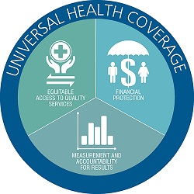
Health Is A Human Right
Key economic policy drivers :
Universal Health Coverage (UHC) –
Access to UHC better protects vulnerable people and supports healthier and more productive communities.

Slide 20
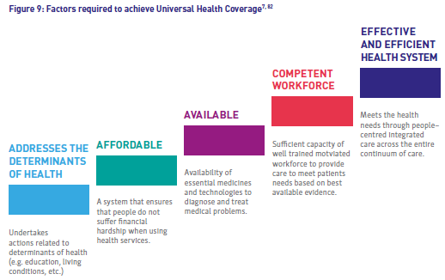
Health Is A Human Right

Slide 21
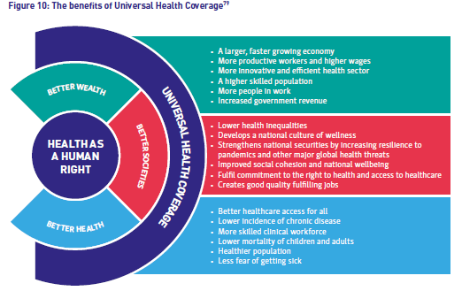

Slide 22
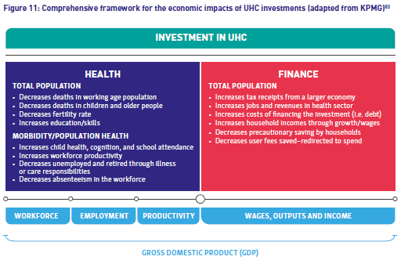

Slide 23
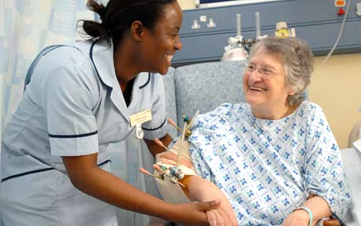
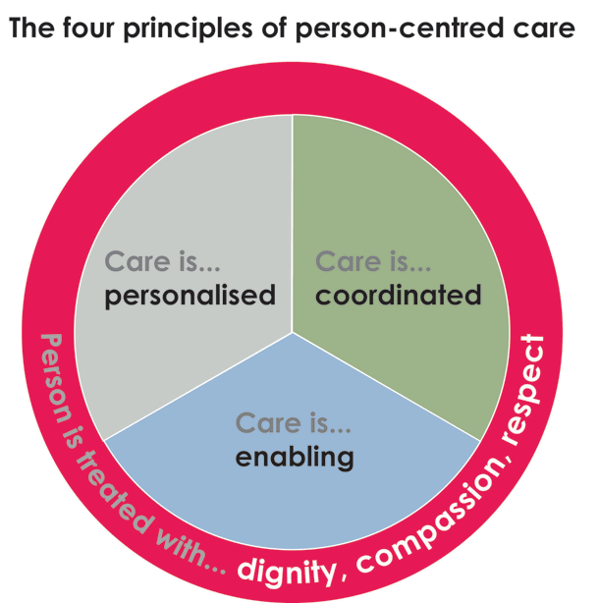
Health Is A Human Right
Key economic policy drivers :
2. People-centred care –
This approach can redirect funding and change health care service models and outcome measures to prioritise patient experiences, public health promotion and equity in health care access.

Slide 24
Holistic People-centred Approach
CONTINUUM CARE
INTERNATIONAL COOPERATION
MONITORING AND ACCOUNTABILITY
STRIKING BALANCES
COORDINATION
LEGAL OBLIGATIONS.

Slide 25
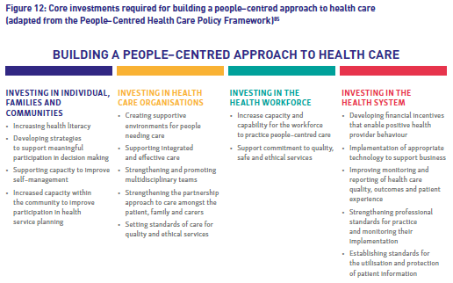

Slide 26

Health Is A Human Right
Key economic policy drivers :
3. Human resources for health –
A sustainable health system requires an appropriately skilled workforce enabled to work to their full scope of practice, that is organised and deployed in innovative ways focusing on primary health care, prevention and health care management.

Slide 27
Health Is A Human Right : Nurse leaders
Responsible for the financial and administrative oversight of health services.
Possess clinical expertise and financial management knowledge and are key decision-makers across health service directorates.
Uniquely skilled and positioned within health policy and process environments to reduce systems fragmentation; identify, inform and implement health systems improvements to drive service improvements; and to promote service safety and quality.
Potentially, efficiently to formulate, deliver a wide range of healthcare services and service innovations and is a centre for implementing human rights approaches to the delivery of healthcare services.

Slide 28
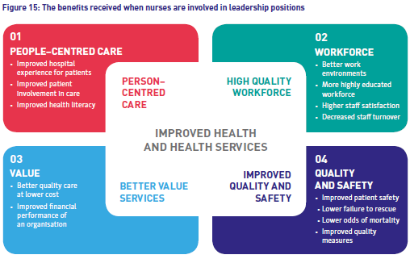

Slide 29
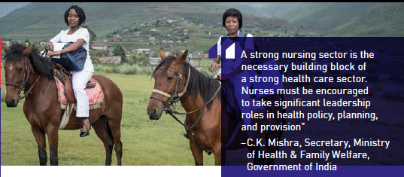
Health Is A Human Right : Nurse leaders

Slide 30
The Final Word From ICN
Nurses are essential in transforming health care and health systems so that no person is left behind.
Nurses can be a voice to lead by improving access to care; enabling a people–centred approach to health; and by ensuring their voices are heard in influencing health policy, planning and provision.
In 2018 it is now time to stand together and speak as one.
We must speak louder. We need to speak clearer.
With the resources that we currently have available to us, it is no longer acceptable to deny any human the right to health care.
Make 2018 your year to be a voice to lead for health is a human right.

Slide 31
References
International Council of Nurses, ‘Nurses a Voice to Lead: Health Is a Human Right, Access, Investment and Economic Growth’ (2018).
Ministry of Health Malaysia Strategic Plan 2006 – 2010. "Towards Achieving Better Health through Consolidation of Services“. http://www.moh.gov.my/images/gallery/Report/MOH_SP_2006-2010.pdf.
Nurses: A voice to lead Health is a human right: Access, investment and economic growth. Australian College of Nursing.
Asher, J. 2004. The Right to Health: A Resource Manual for NGOs. New York Ave., NW, Washington D.C.USA.

Slide 32
Thanks
Any questions?

